Slide 1
Cyclistic Case Study
BY OMKAR MORE
02-06-2024

Slide 2
OBJECTIVE
Identify a way to convert casual riders to annual member
Check Differences between Casual and Member riders

Slide 3
ABOUT CYCLISTIC
Cyclistic, a bike-share company launched in 2016, operates 5,824 geotracked bicycles across 692 stations in Chicago. The bikes can be rented and returned at any station, with flexible pricing options.
A bike-share program that features more than 5,800 bicycles and 600 docking stations. Cyclistic sets itself apart by also offering reclining bikes, hand tricycles, and cargo bikes, making bike-share more inclusive to people with disabilities and riders who can’t use a standard two-wheeled bike. The majority of riders opt for traditional bikes; about 8% of riders use the assistive options. Cyclistic users are more likely to ride for leisure, but about 30% use the bikes to commute to work each day.

Slide 4
ABOUT CYCLISTIC’S PRICING PLANS
Cyclistic currently offers 3 plans
Single-ride Pass
Full-day Pass
Annual Membership

Slide 5
DATA ANALYSED
Data analyzed consists of past 12 months records of Cyclistic this was by DIVVY
The Data consisted from 01/2022 to 12/2022 and had 56 Lakh data points
The data had a high integrity as it was 1st Party

Slide 6
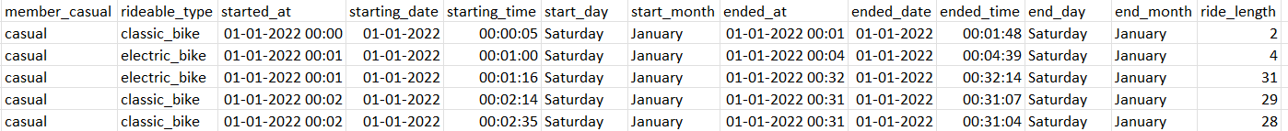
THE PROCESS
R Programming and Tableau was used
Before
After

Slide 7
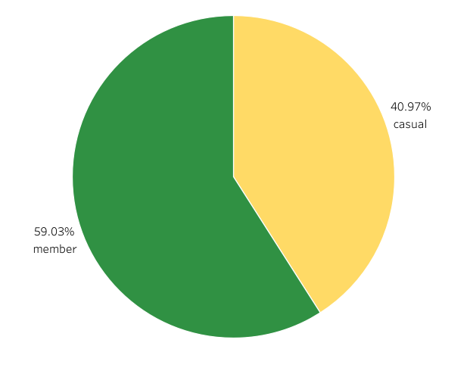

OVERALL RIDERS
Total Rider 5,667,717 as of 2022
59% are Members
40% are Casuals

Slide 8
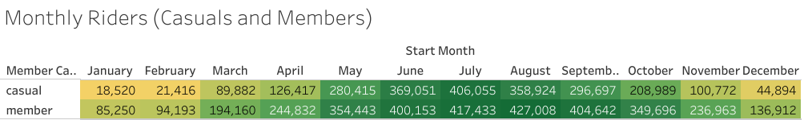
MONTHLY RIDERS
Busiest month was July for both Casual and Members Total :- 8,23,488
Lowest month was January for both Casual and Members Total :- 1,03,770
Data Shows that members lowest numbers weren’t as low as casual pass owners

Slide 9
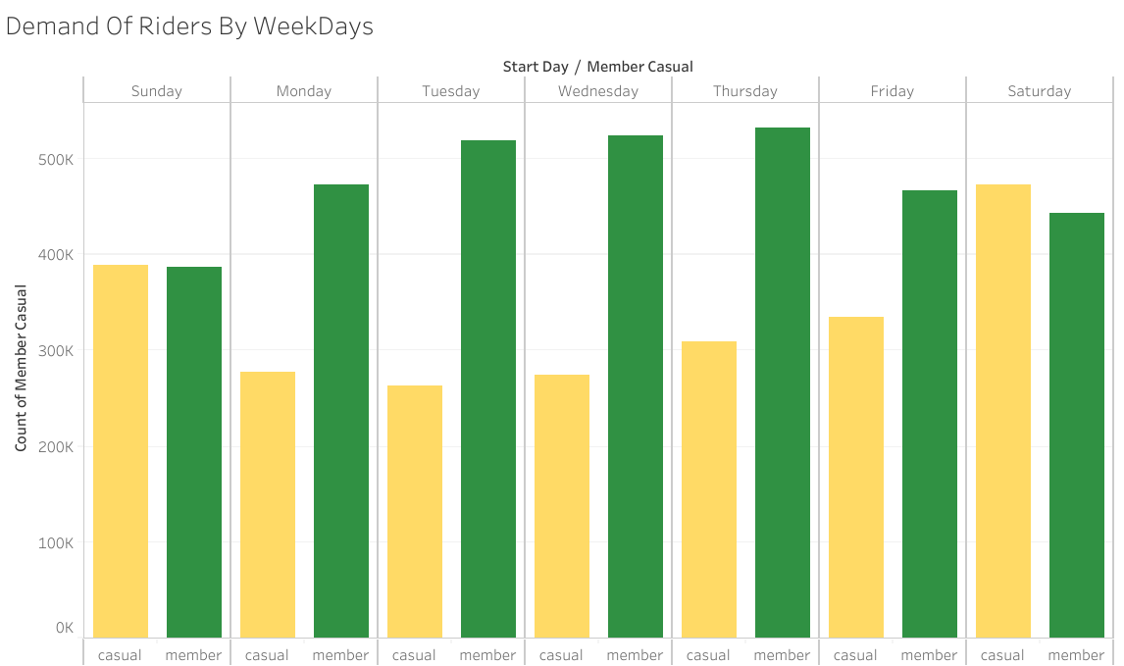

DAILY RIDERS
Members ride more during week
days
Casuals ride more during weekends

Slide 10
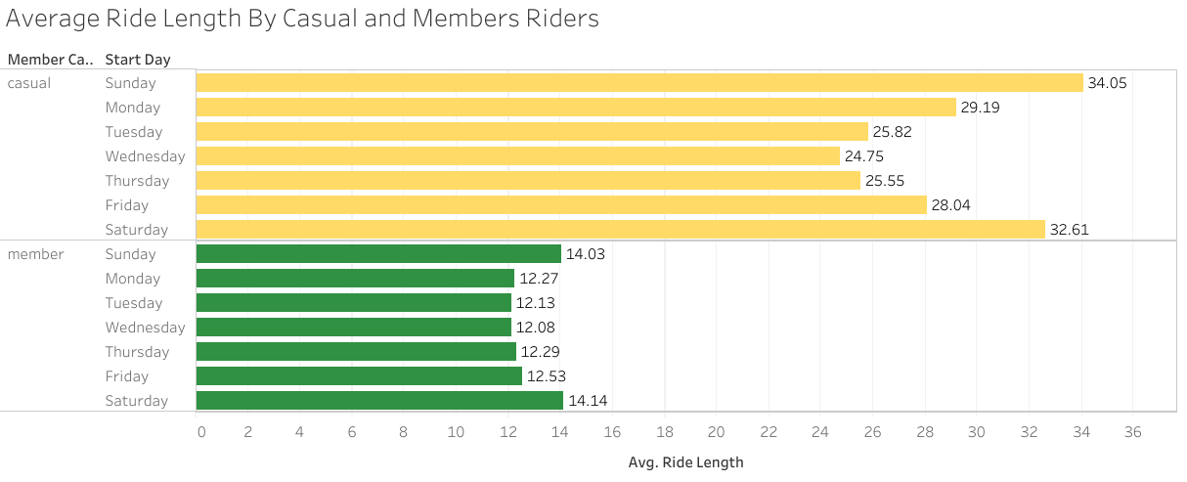

AVERAGE RIDE DURATION
Casuals ride for more duration than members
whereas
Members ride for less than 15 mins

Slide 11
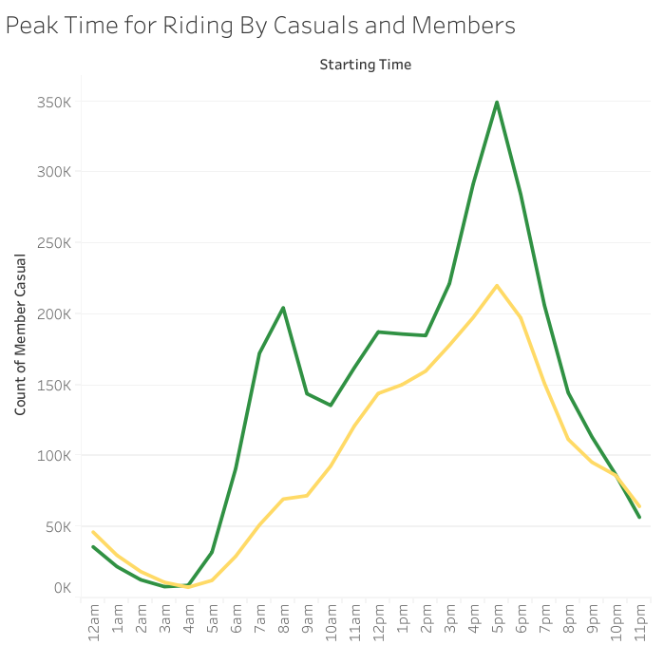
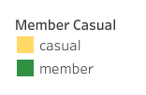
RIDE START TIME
Casual riders and Member riders both peak at 5 pm
But a peak is seen in Member riders at 7 am
It shows that members often use to travel to their
workplace

Slide 12
INSIGHTS
Common Between Both
Members and Casuals
Ride more during Summer Season
Ride less during winter Season
Members
Ride more during week days
Have shorter riding time
Mainly use it to travel to work place
Casuals
Ride more during weekends
Have longer riding time
Mainly use it for leisure activities

Slide 13
SUGGESTIONS
IDEA – 1
Offer a Seasonal Pass targeting Seasons were Casual Pass owners can own a Seasonal Pass Providing a Value for money benefit over normal day pass or ride pass
IDEA – 2
Offer a Monthly Pass targeting Casual Pass owners who use the Cyclist service more often providing the same benefits as Annual Membership

Slide 14
Thank you
Presented By :- Omkar More

